Slide 1
Divers Maximum
Umbilical Excursion Lengths
from the DP Vessel Side
Supervisors Manual
Calculation Checks
PART
1

Slide 2
The umbilical excursion Dwgs and calculations are usually carried out by the Engineers onshore during the project preparation phase;
Supervisors should have a knowledge and understanding on how to check that these dimensions are correct;
The information below is a basic trigonometry check and is relatively easy to understand.

Slide 3
From the Plan dwg of the deck with the Divers LARS in position you need to know one dimension from the Dwg;
From SK-UEX-001-01 we will use the known value 43.221m.

Slide 4
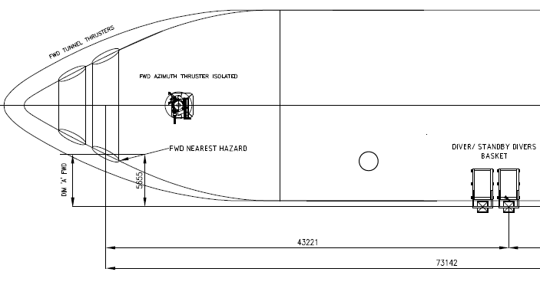
The one dimension we know and will use will be from SK-UEX-001-01 and we will use the known value 43221 (43.221 metres);
Print off an A4 copy of SK-UEX-001-01& 02;
Using a Ruler measure the distance 43221;
You should get a measurement of approximately 116.9 mm;
Divide 43221 by 116.9 to get a scaling Ratio of 369.73.

Slide 5
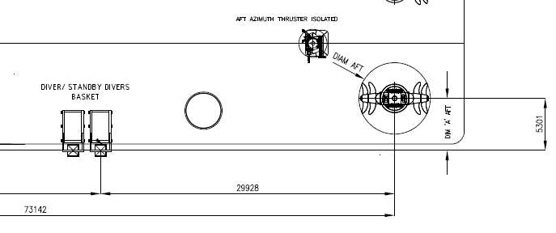
Next measure the offset Dimension ‘A’, at the Aft hazard, from the centre of rotation on the Azimuth to the centre of the divers basket;
Aft Dim ‘A’ measurement = 14.3 mm;
Multiply by the Ratio = 5.29 m;
From the dimension 5.301 at the aft end of the sketch you will notice there is a slight error;

Slide 6
This error is due to the accuracy of the measurement made by the ruler;
Next measure Dim ‘A’ from the centre of the Fwd hazard to centre of the divers basket;
You should get a measurement of approximately 15.2 mm;
Multiply this value by the ratio = 5.62 m, which is pretty close to the actual value;
With each measurement the error will compound itself, but as long as the final result is less than 0.5 m then you could say that the check is acceptable against the engineered calculations;
We will now calculate for the divers umbilical excursion at 15 msw;

Slide 7
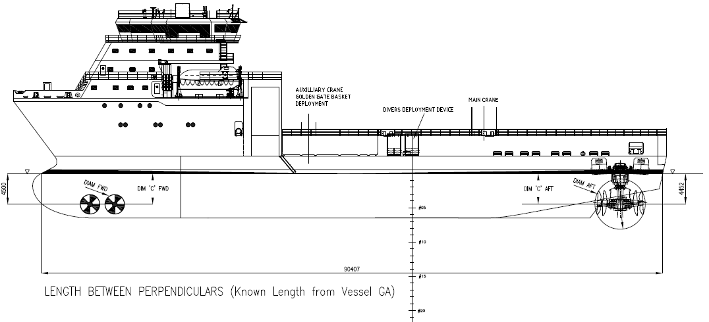
We need to calculate the Ratio to scale the next Dwg – SK-UEX-001-02;
The measurement 90407 by measurement is 210 mm;
Ratio = 430.509;
We will now calculate for the divers umbilical excursion at 15 msw;
From the 15 m mark for the divers basket depth measure to the centre of rotation on the Aft Azimuth;
You should get a measurement close to 74.5 mm;
Multiply this by the Ratio = 32.07 m;

Slide 8
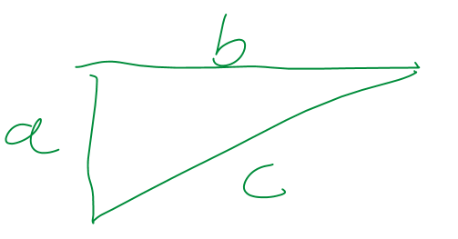
Now use Pythagoras Theorem to calculate the next step;
C = (32.072² + 5.319²)^{1/2}
C = 32.51 m;
Next we have to subtract the radius of the sphere around the Azimuth to get the distance to the closest point from the 15 msw mark to the centre of the Azimuth to a point where the line intersects the sphere ;
You should measure the diameter of the sphere to be approximately 17.5 mm;
Multiply this by the Ratio = 7.533 m;

Slide 9
We now subtract the radius of the sphere ( D/2) = 3.766 m = 28.74 m;
Next we subtract 5 m from this value which will be the final result = 23.74 m;

Slide 10
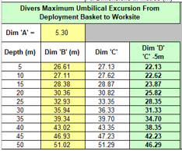
Next we confirm the dimension against the engineered calculations;
Engineered Excursion Calculations
Supervisors Excursion Calculation Checks
Error
23.87 – 23.74 = 130 mm, which for a scaled check is acceptable and you should now compare the rest of the depths against the supplied excursion chart to give you confidence that the Engineered calculations are good.

Slide 11
Exercise 1
Repeat this exercise using manual calculations but this time use the dimension of 73142 mm from Sketch 001 and compare your answers

Slide 12
Exercise 2
Repeat this exercise using manual calculations but this time use the Fwd Dim ‘A’ of 5655 mm from Sketch 001 and compare your answers.
You will notice that some will be closer to the engineered answer and some not.
It is all down to the accuracy of how you take your measurements.

Slide 13
Thank you for downloading and taking the time to go through these presentations, if you have any queries I can be contacted at: amelia@namakasubsea.com
In addition to this presentation we have the following presentations to complete the suite of Supervisor calculation checks:
Divers umbilical excursion calculation checks from a DSV when diving through a moonpool;
Standby divers umbilical excursion calculation checks from a DSV when diving through a moonpool;
Standby divers umbilical excursion calculation checks from the DSV deployment device to the worksite;
Divers extended umbilical calculation checks from the in water tend point (Golden Gate) to the worksite;
Standby divers extended umbilical calculation checks from the in water tend point (Golden Gate) to the worksite;

Slide 14
Trigonometry calculations made easy;
With the full package all calculations will be supplied in Microsoft Excel format to make the checks easier, quicker and help reduce the amount of hand calculations.
This complete suite of presentations will guide you through the process and gives you the required tools to allow you to carry out these umbilical excursion calculation checks.
Please note, Namaka Subsea does not take any responsibility for any errors made in the scaling, this package is simply to be used as a method for checking the supplied Engineered umbilical excursion calculations, which are sometimes wrong from time to time, especially when the DSV has to get to the 10 m limit from the asset.
These calculations are not meant to replace the Engineered calcs and as such shall not be used to do so.

Slide 15
Namaka Subsea will soon be offering modernised Air Diver Supervisor Training courses where all of the above will be part of the training and material issued to the students.
For details on how to get this full package, please visit our web site for the contact details and associated costs.
www.namakasubsea.com
PART
1

